Slide 1
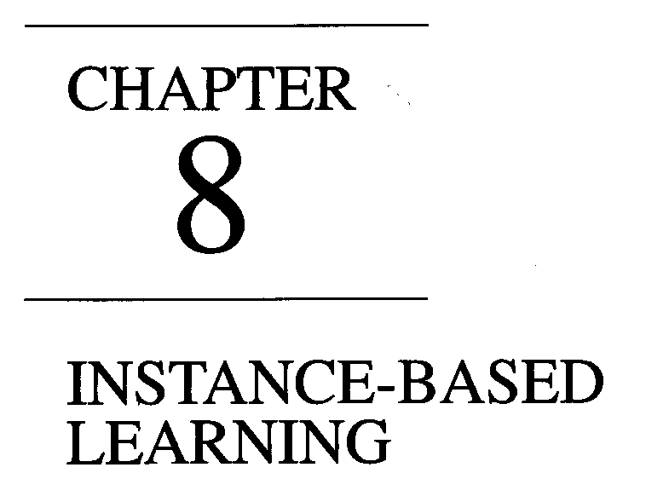
Instance Based Learning
B. Tech III Year
CS 701 PC

Slide 2
8.1 | Introduction
8.2 | K- nearest neighbour algorithm
8.3 | Locally Weighted Regression
8.4 | Radial Basis Function (RBF)
8.5 | Case Bases reasoning (CBR)
8.6 | Remarks on Lazy and Eager Learning

Slide 3
INSTANCE BASED LEARNING
Synonym: Memory-based learning
8.1 INTRODUCTION
In contrast to learning methods that construct a general, explicit description of the target function when training examples are provided, instance-based learning methods simply store the training examples. Generalizing beyond these examples is postponed until a new instance must be classified.
Each time a new query instance is encountered, its relationship to the previously stored examples is examined in order to assign a target function value for the new instance.
Instance based learning includes nearest neighbour and locally weighted regression methods that assume instances can be represented as points in a Euclidean space.

Slide 4
It also includes case-based reasoning methods that use more complex, symbolic representations for instances. Instance-based methods are sometimes referred to as "lazy" learning methods because they delay processing until a new instance must be classified.
A key advantage of this kind of delayed, or lazy, learning is that instead of estimating the target function once for the entire instance space, these methods can estimate it locally and differently for each new instance to be classified.
Instance-based learning methods such as nearest neighbor and locally weighted regression are conceptually straightforward approaches to approximating real-valued or discrete-valued target functions.
Learning in these algorithms consists of simply storing the presented training data.
When a new query instance is encountered, a set of similar related instances is retrieved from memory and used to classify the new query instance.

Slide 5
Instance based learning is a family of learning algorithms that, instead of performing explicit generalization, compares new problem instances with instances seen in training, which have been stored in memory. It is called instance-based because it evaluates test cases directly based on the training instances themselves.
INSTANCE BASED APPROACH Vs OTHERS
One key difference between these approaches and the methods
discussed in other chapters is that instance-based approaches can construct
a different approximation to the target function for each distinct query instance
that must be classified.
In fact, many techniques construct only a local approximation to the target function that applies in the neighborhood of the new query instance, and never construct an approximation designed to perform well over the entire instance space.
This has significant advantages when the target function is very complex, but can still be described by a collection of less complex local approximations.

Slide 6
One advantage that instance based learning has over other methods of machine learning is its high flexibility to adapt its model to previously unseen data.
Instance-based learners may store a new instance and/or throw an old instance away.
Instance-based methods can also use more complex, symbolic representations for instances.
In case-based learning, instances are represented in this fashion and the process for identifying "neighboring" instances is elaborated accordingly.
Case-based reasoning has been applied to tasks such as storing and reusing past experience at a help desk, reasoning about legal cases by referring to previous cases, and solving complex scheduling problems by reusing relevant portions of previously solved problems.
One disadvantage of instance-based approaches is that the cost of classifying new instances can be high. This is due to the fact that nearly all computation takes place at classification time rather than when the training examples are first encountered.
Therefore, techniques for efficiently indexing training examples are a significant practical issue in reducing the computation required at query time.
A second disadvantage to many instance-based approaches, especially nearest neighbor approaches, is that they typically consider all attributes of the instances when attempting to retrieve similar training examples from memory. If the target concept depends on only a few of the many available attributes, then the instances that are truly most "similar" may well be a large distance apart.

Slide 7
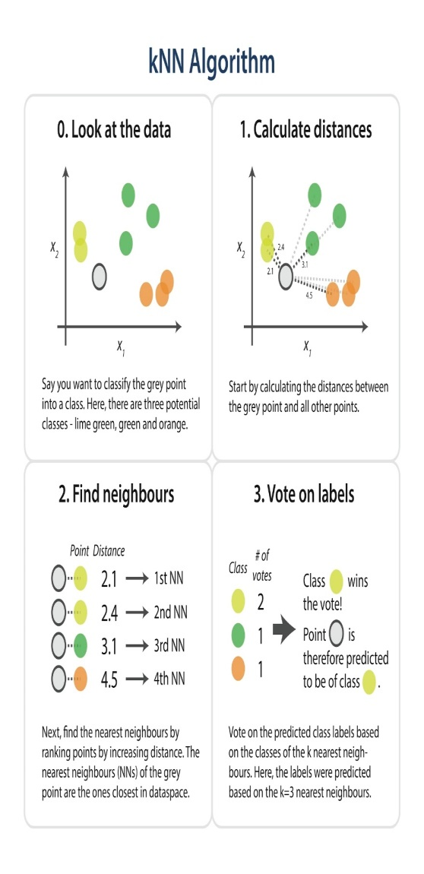
K-Nearest Neighbor Algorithm (KNN)
The most basic instance-based method is the k-NEAREST NE IGHBOR algorithm.
This algorithm assumes all instances correspond to points in the n-dimensional space R^n.
In the k-nearest neighbors algorithm (k-NN) the analysis is based on the k closest training examples in the instance space.
k is a predefined positive integer, typically small and odd. Potentially an optimal k can be calculated by special techniques (hyper parameter optimization techniques)
The typical representation of an instance x is a feature vector ( a1(x), a2(x),....an(x)) + a target function f(x). The training phase is simply the storage of the feature vectors of all training instances in a datastructure.

Slide 8

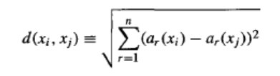
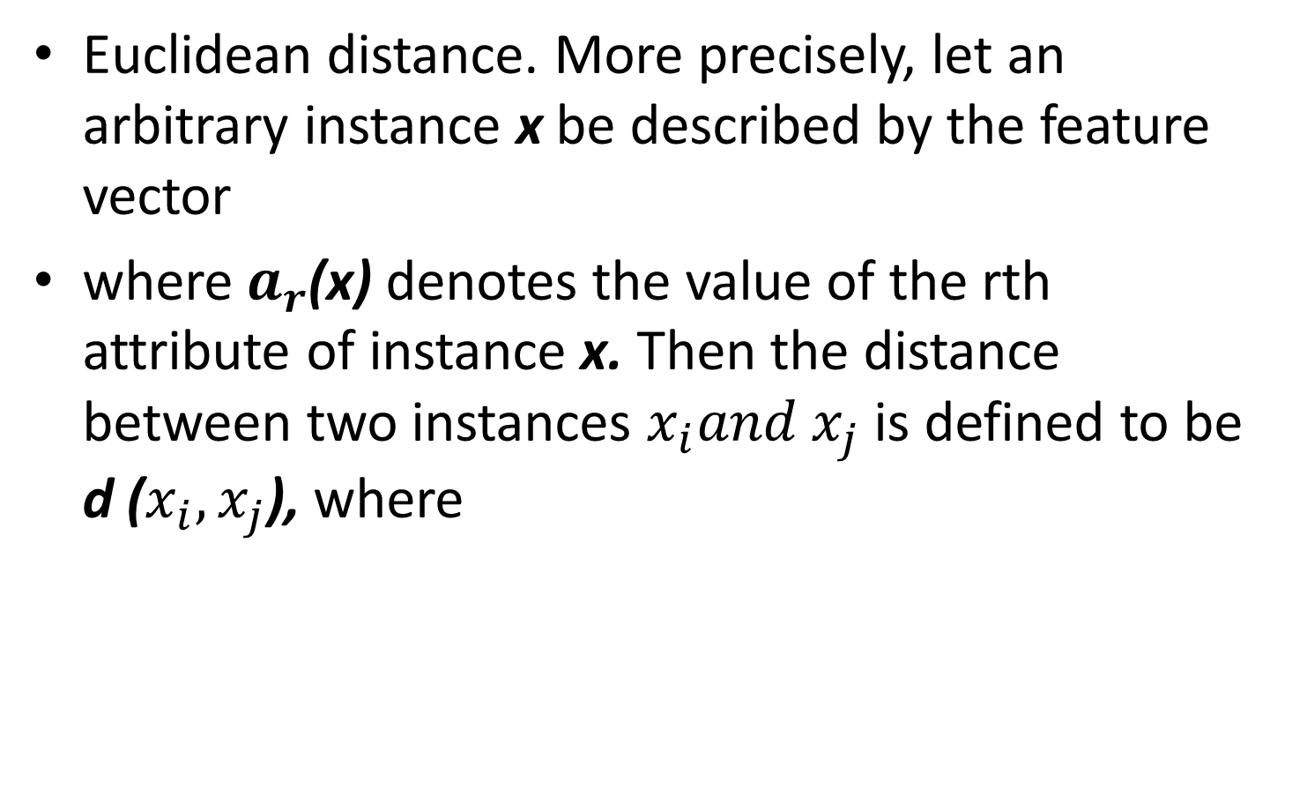
Euclidean distance. More precisely, let an arbitrary instance x be described by the feature vector
where $a_{r}$(x) denotes the value of the rth attribute of instance x. Then the distance between two instances $x_{i}{and x}_{j}$ is defined to be d ($x_{i},x_{j}$), where

Slide 9
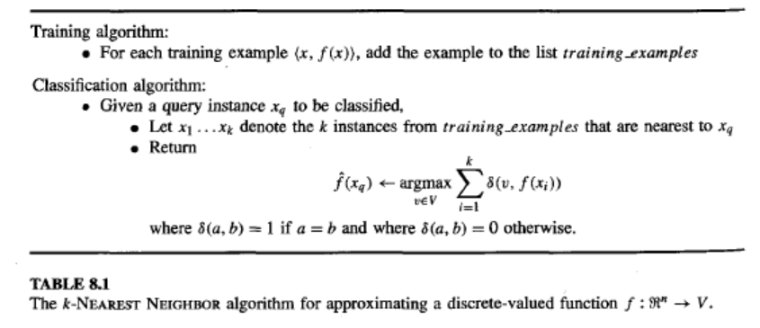

In nearest-neighbor learning the target function may be either discrete-valued or real-valued.
Let us first consider learning discrete-valued target functions of the form$f:R^{n}→V$, where V is the finite set {$v_{1},v_{2},…..,v_{s}$}.
The KNN algorithm for approximating a discrete-valued target function is

Slide 10
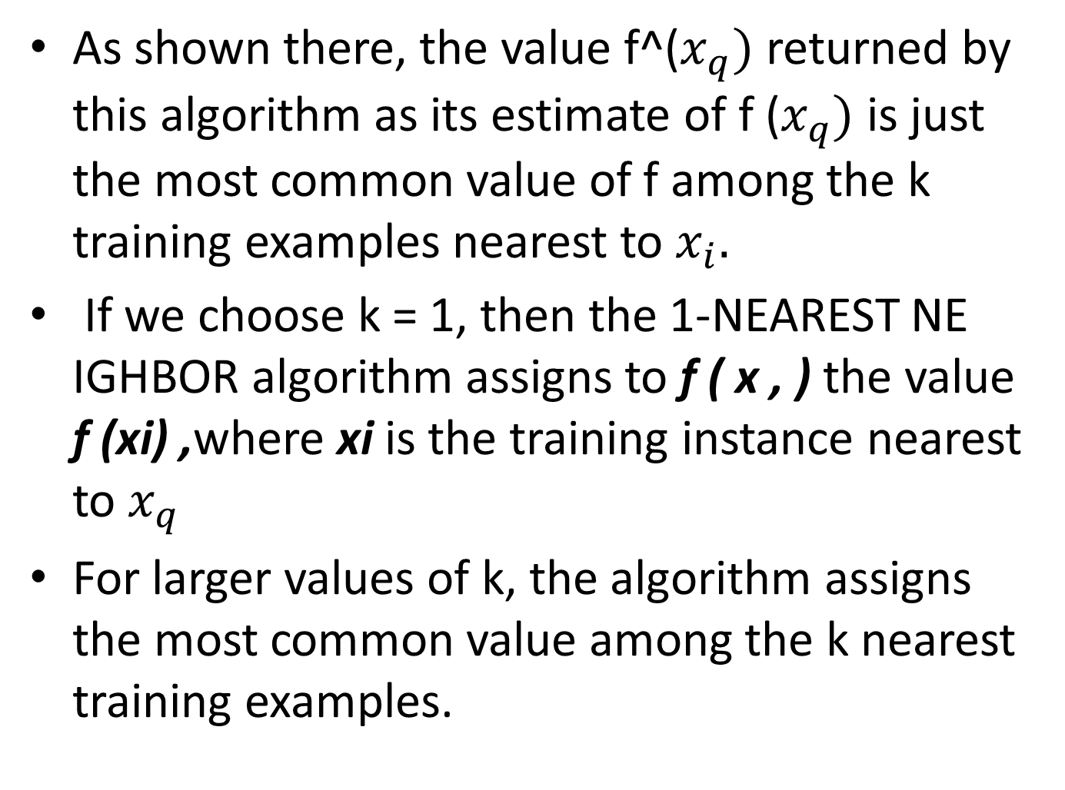
As shown there, the value f^($x_{q})$ returned by this algorithm as its estimate of f ($x_{q})$ is just the most common value of f among the k training examples nearest to $x_{i}.$
If we choose k = 1, then the 1-NEAREST NE IGHBOR algorithm assigns to f ( x , ) the value f (xi) ,where xi is the training instance nearest to $x_{q}$
For larger values of k, the algorithm assigns the most common value among the k nearest training examples.

Slide 11
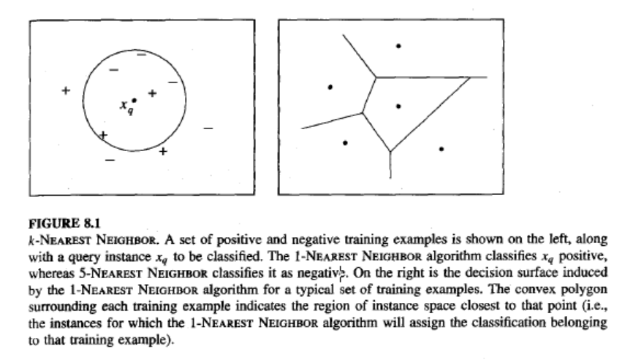
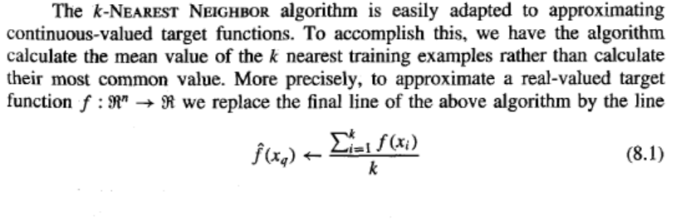
Voronoi diagram

Slide 12
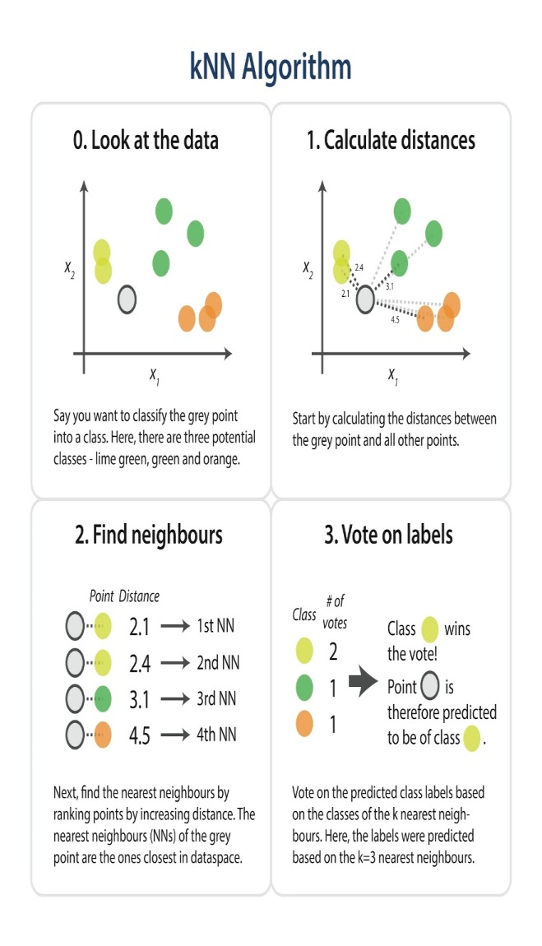
K-Nearest Neighbor Algorithm (KNN)
A distance metric is always needed. A default metric is the Euclidean distance
d(xi,xj) = sqrt ((r=1..n) :Sum ( ar(xi)-ar(xj))^2)). A metric is typically manually defined but can also be learned.
The k-NN algorithm can be used both for classification or regression:
In k-NN classification, the output is a class membership. A query instance (xq) is assigned the class label most common among its k nearest neighbors. If k = 1, then the instance is simply assigned the class of that single nearest neighbor.
In k-NN regression, the output is the property value for the query instance (xq). This value is the average of the values of its k nearest neighbors.
For examples we will use binary classifications in a feature space of two dimensions.

Slide 13
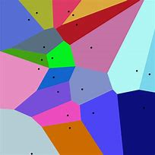
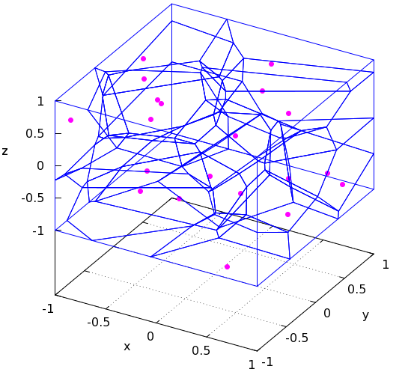
Implicit representation or visualization of the Hypothesis space
It is obvious that in the case of instance-based learning there is only one explicit space, the instance space. A hypothesis is never explicitly built up.
The ´hypotheses´ are implicit in the structure of the instance space.
One form of such implicit representations is the so called Voronoi Diagram.
A Voronoi Diagram is a partitioning of the decision surface into convex polyhedral surroundings of the training instances.
Each polyhedron covers the potential query instances positively determined by a training instance. Query points outside a specific polyhedron is closer to another training instance.
The approch can be extended to a number of dimensions larger than 2.

Slide 14
Issues to consider for the k2-nearest neighbor algorithm
In binary (two class) classification problems, it is helpful to choose k to be an odd number as this avoids tied votes. One way of choosing the empirically optimal k in this setting is via the bootstrap method.
The principle of "majority voting" for deciding the class labels can be problematic when the class distribution is skewed.
Instances of a more frequent class tend to dominate the prediction of the new examples, because they tend to be more common among the k nearest neighbors due to their large number.
Irrelevant features within a large feature set, tend to degrade performance.
The simple model where all instances are treated fairly using the same distance metric may be inadequate e.g. in sparse instance spaces.

Slide 15
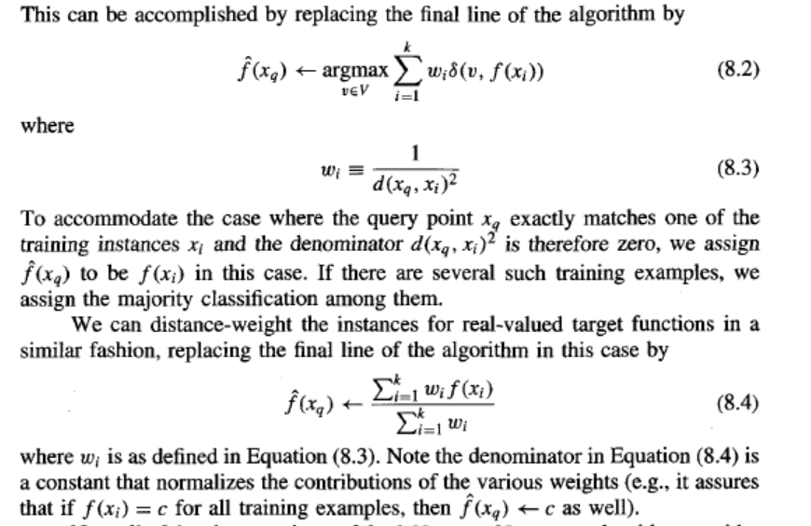
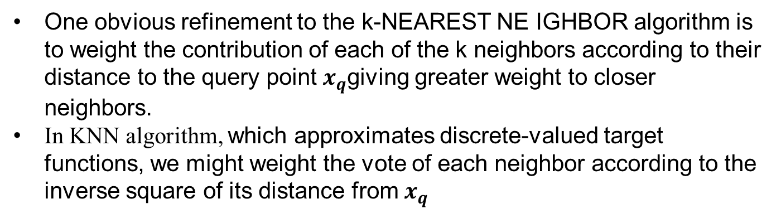
Distance-Weighted Nearest Neighbor Algorithm
One obvious refinement to the k-NEAREST NE IGHBOR algorithm is to weight the contribution of each of the k neighbors according to their distance to the query point $x_{q}$giving greater weight to closer neighbors.
In KNN algorithm, which approximates discrete-valued target functions, we might weight the vote of each neighbor according to the inverse square of its distance from $x_{q}$

Slide 16
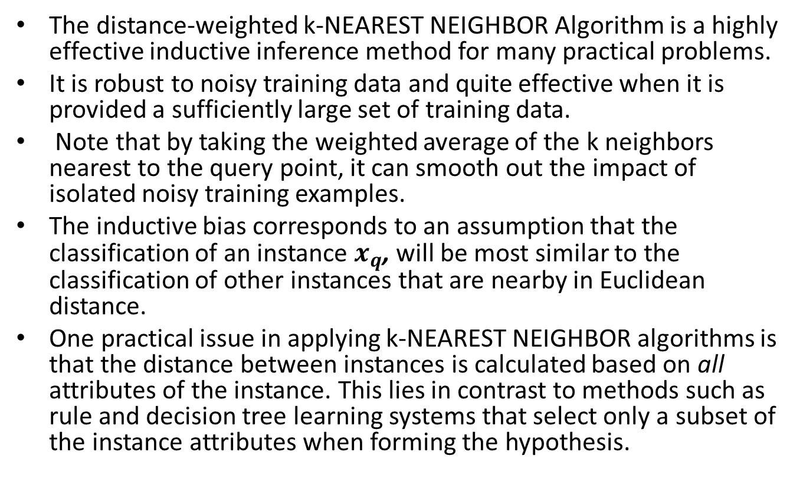
Remarks on k-NEAREST NEIGHBOR Algorithm
The distance-weighted k-NEAREST NEIGHBOR Algorithm is a highly effective inductive inference method for many practical problems.
It is robust to noisy training data and quite effective when it is provided a sufficiently large set of training data.
Note that by taking the weighted average of the k neighbors nearest to the query point, it can smooth out the impact of isolated noisy training examples.
The inductive bias corresponds to an assumption that the classification of an instance $x_{q}$, will be most similar to the classification of other instances that are nearby in Euclidean distance.
One practical issue in applying k-NEAREST NEIGHBOR algorithms is that the distance between instances is calculated based on all attributes of the instance. This lies in contrast to methods such as rule and decision tree learning systems that select only a subset of the instance attributes when forming the hypothesis.

Slide 17
The distance between neighbors will be dominated by the large number of irrelevant attributes. This difficulty, which arises when many irrelevant attributes are present, is sometimes referred to as the curse of dimensionality.
Nearest-neighbor approaches are especially sensitive to this problem. One interesting approach to overcoming this problem is to weight each attribute differently when calculating the distance between two instances.
This corresponds to stretching the axes in the Euclidean space, shortening the axes that correspond to less relevant attributes, and lengthening the axes that correspond to more relevant attributes.
The amount by which each axis should be stretched can be determined automatically using a cross-validation approach.

Slide 18
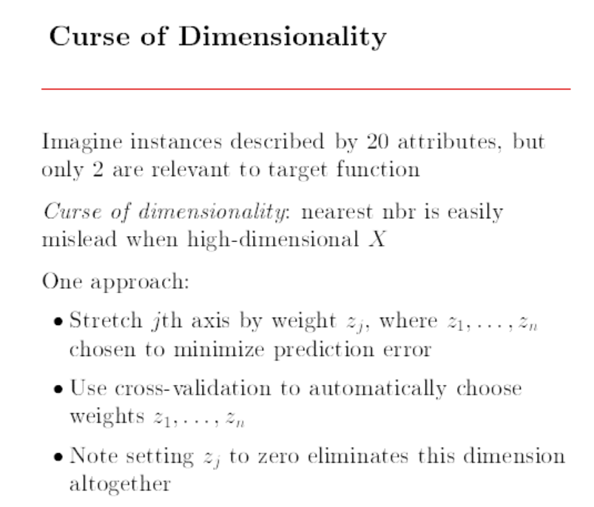

Slide 19

One additional practical issue in applying k-NEAREST NEIGHBOR’S efficient
memory indexing.
Because this algorithm delays all processing until a new query
is received, significant computation can be required to process each new query.
Various methods have been developed for indexing the stored training examples so
that the nearest neighbors can be identified more efficiently at some additional cost
in memory.
One such indexing method is the kd-tree in which instances are stored at the leaves of a tree, with nearby instances stored at the same or nearby nodes. The internal nodes of the tree sort the new query $x_{q}$, to the relevant leaf by testing selected attributes of $x_{q}$.

Slide 20
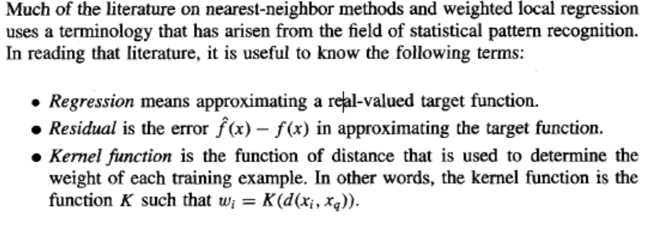
TERMINOLOGY

Slide 21
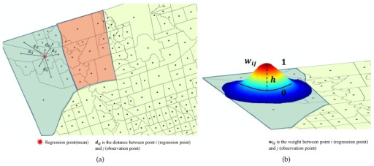
Locally Weighted Regression
The nearest neighbor approaches approximate a target function for a single query instance (xq).
Locally weighted regression (LWR) is an extension of this approach. It constructs an explicit approximation of the target function over a local region surrounding xq. The approximation may be a linear function, a quadratic function etc.
The term ”local” in term locally weighted regression is motivated by the fact that approximation is based only on data near to xq.
The term ”weighted” is motivated by the fact that the contribition of training instances are weighted based on the distance from xq. The weights are defined by a so called kernel function. One can say that the kernel function moderates the original distance measure.
The term regression is motivated by the fact that we aim at approximating real-valued functions.

Slide 22
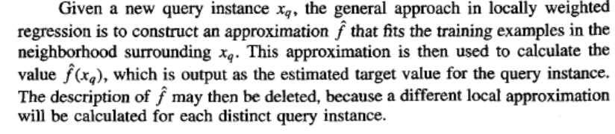
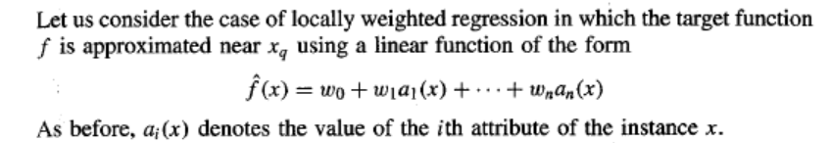

Locally Weighted Linear Regression
In Chapter 4 we discussed methods such as gradient descent to
find the coefficients wo . . . w, to minimize the error in fitting such linear functions to a given set of training examples. Therefore, we derived methods to choose weights that minimize the squared error summed over the set D of training examples

Slide 23
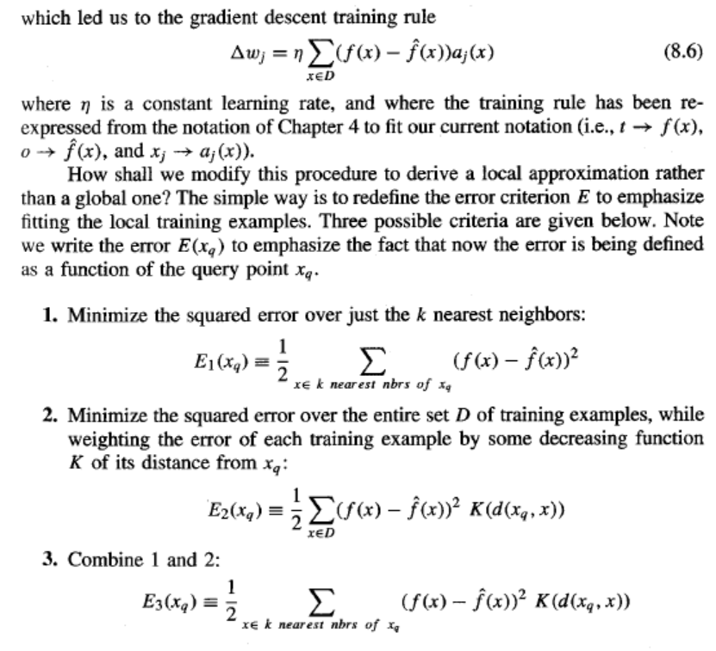

Slide 24
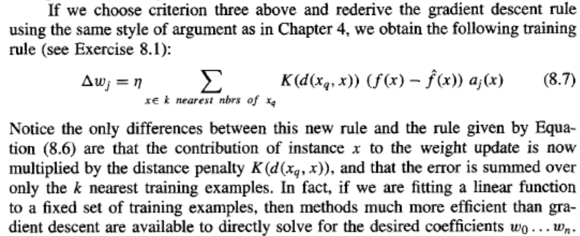
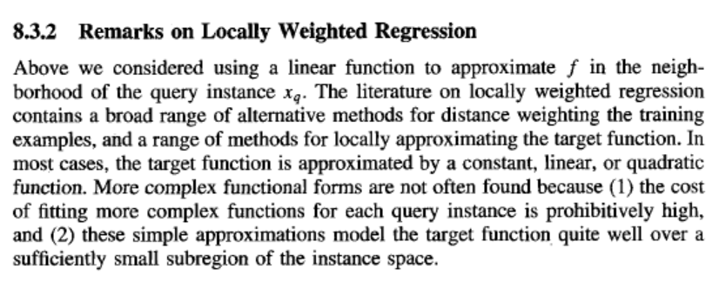

Slide 25

8.4 | Radial Basis Function (RBF)
One approach to function approximation that is closely related to distance-weighted regression and also to artificial neural networks is learning with radial basis functions In this approach, the learned hypothesis is a function of the form
where ,each x_{u} is an instance from X and where the kernel function K_{u} (d(x_{u} , x))
is defined so that it decreases as the distance d(x_{u} , x) increases.
Here k is a user provided constant that specifies the number of kernel functions to be included.
Even though f^ (x) is a global approximation to f (x), the contribution from each of the Ku(d (x_{u} , x)) terms is localized to a region nearby the point x.
t is common to choose each function K_{u} (d (x_{u} , x)) to be a Gaussian function centred at the point x_{u} with some variance

Slide 26

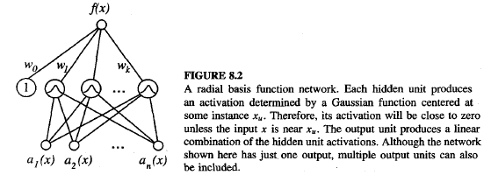
We will restrict our discussion here to this common Gaussian kernel function.
The functional form of Equation (8.8) can approximate any function with arbitrarily small error, provided a sufficiently large number k of such Gaussian kernels and provided the width a2 of each kernel can be separately specified.
The function given by Equation (8.8) can be viewed as describing a two layer network where the first layer of units computes the values of the various Ku(d(xu, x)) and where the second layer computes a linear combination of these first-layer unit values. An example radial basis function (RBF) network is illustrated in Figure 8.2.

Slide 27
A second approach is to choose a set of kernel functions that is smaller than the number of training examples.
This approach can be much more efficient than the first approach, especially when the number of training examples is large.
The set of kernel functions may be distributed with centers spaced uniformly throughout the instance space X.
Alternatively, we may wish to distribute the centers non uniformly, especially if the instances themselves are found to be distributed non uniformly over X.
Alternatively, we may identify prototypical clusters of instances, then add a kernel function centered at each cluster. The placement of the kernel functions in this fashion can be accomplished using unsupervised clustering algorithms that fit the training instances (but not their target values) to a mixture of Gaussians.(EX: EM algorithm)

Slide 28
To summarize, radial basis function networks provide a global approximation to the target function, represented by a linear combination of many local kernel functions.
The value for any given kernel function is non-negligible only when the input x falls into the region defined by its particular center and width. Thus, the network can be viewed as a smooth linear combination of many local approximations to the target function.
One key advantage to RBF networks is tha they can be trained much more efficiently than feed forward networks trained with BACKPROPAGATION . This follows from the fact that the input layer and the output layer of an RBF are trained separately.

Slide 29
8.5 | Case Bases Reasoning (CBR)
Instance-based methods such as k-NEAREST NEIGHBOUR locally weighted regression share three key properties.
First, they are lazy learning methods in that they defer the decision of how to generalize beyond the training data until a new query instance is observed.
Second, they classify new query instances by analyzing similar instances while ignoring instances that are very different from the query.
Third, they represent instances as real-valued points in an n-dimensional Euclidean space.
Case-based reasoning (CBR) is a learning paradigm based on the first two of these principles, but not the third.
In CBR, instances are typically represented using more rich symbolic descriptions, and the methods used to retrieve similar instances are correspondingly more elaborate.

Slide 30
CBR has been applied to problems such as conceptual design of mechanical devices based on a stored library of previous designs , reasoning about new legal cases based on previous rulings , solving planning and scheduling problems by reusing and combining portions of previous solutions to similar problems.
Consider a prototypical example of a case-based reasoning system to ground our discussion - The CADET system:
It employs case based reasoning to assist in the conceptual design of simple mechanical devices such as water faucets.
It uses a library containing approximately 75 previous designs and design fragments to suggest conceptual designs to meet the specifications of new design problems.
Each instance stored in memory (e.g., a water pipe) is represented by describing both its structure and its qualitative function.
New design problems are then presented by specifying the desired function and requesting the corresponding structure.

Slide 31
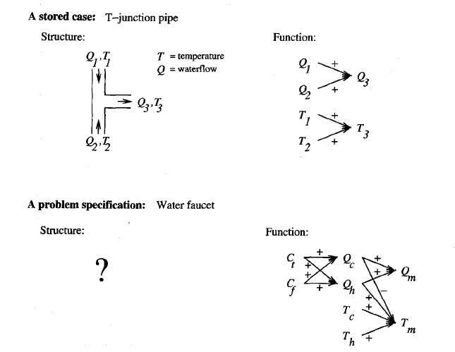
FIGURE 8.3
A stored case and a new problem. The top half of the figure describes a typical design fragment in the case library of CADET. The function is represented by the graph of qualitative dependencies among the T-junction variables (described in the text). The bottom half of the figure shows a typical design problem

Slide 32
The top half of the figure shows the description of a typical stored case called a T-junction pipe.
Its function is represented in terms of the qualitative relationships among the water flow levels and temperatures at its inputs and outputs.
In the functional description at its right, an arrow with a "+" label indicates that the variable at the arrowhead increases with the variable at its tail. For example, the output waterflow Q3 increases with increasing input waterflow Ql.
Similarly, a "-" label indicates that the variable at the head decreases with the variable at the tail.
The bottom half of this figure depicts a new design problem described by its desired function. This particular function describes the required behavior of one type of water faucet.

Slide 33
Here Qc, refers to the flow of cold water into the faucet, Qh to the input flow of hot water, and Qm, to the single mixed flow out of the faucet.
Similarly, Tc, Th, and Tm, refer to the temperatures of the cold water, hot water, and mixed water respectively.
The variable Ct, denotes the control signal for temperature that is input to the faucet, and Cf denotes the control signal for waterflow. Note the description of the desired function specifies that these controls Ct, and Cf are to influence the water flows Qc, and Qh, thereby indirectly influencing the faucet output flow Qm, and temperature Tm.
Given this functional specification for the new design problem, CADET searches its library for stored cases whose functional descriptions match the design problem.
If an exact match is found, indicating that some stored case implements exactly the desired function, then this case can be returned as a suggested solution to the design problem.
If no exact match occurs, CADET may find cases that match various subgraphs of the desired functional specification

Slide 34

In Figure 8.3, for example, the T-junction function matches a subgraph of the water faucet function graph.
More generally, CADET searches for subgraph isomorphism between the two function graphs, so that parts of a case can be found to match parts of the design specification.
Furthermore, the system may elaborate the original function specification graph in order to create functionally equivalent graphs that may match still more cases.
It uses general knowledge about physical influences to create these elaborated function graphs.
For example, it uses a rewrite rule that allows it to rewrite the influence

Slide 35
This rewrite rule can be interpreted as stating that if B must increase with A then it is sufficient to find some other quantity x such that B increases with x, and x increases with A.
Here x is a universally quantified variable whose value is bound when matching the function graph against the case library.
In fact, the function graph for the faucet shown in Figure 8.3 is an elaboration of the original - functional specification produced by applying such rewrite rules.
By retrieving multiple cases that match different subgraphs, the entire design can sometimes be pieced together.
In general, the process of producing a final solution from multiple retrieved cases can be very complex. It may require designing portions of the system from first principles, in addition to merging retrieved portions from stored cases.
It may also require backtracking on earlier choices of design subgoals and, therefore, rejecting cases that were previously retrieved.
CADET has very limited capabilities for combining and adapting multiple retrieved cases to form the final design and relies heavily on the user for this adaptation stage of the process.
CADET is a research prototype system intended to explore the potential role of case-based reasoning in conceptual design. It does not have the range of analysis algorithms needed to refine these abstract conceptual designs into final designs

Slide 36
It is instructive to examine the correspondence between the problem setting of CADET and the general setting for instance-based methods such as k-NEAREST NEIGHBOR.
In CADET each stored training example describes a function graph along with the structure that implements it.
New queries correspond to new function graphs.
Thus, we can map the CADET problem into our standard notation by defining the space of instances X to be the space of all function graphs.
The target function f maps function graphs to the structures that implement them.
Each stored training example (x, f (x)) is a pair that describes some function graph x and the structure f ( x ) that implements x.
The system must learn from the training example cases to output the structure f (xq) that successfully implements the input function graph query xq.

Slide 37
The above sketch of the CADET system illustrates several generic properties of case-based reasoning systems that distinguish them from approaches such as k-NEAREST NEIGHBOR.
Instances or cases may be represented by rich symbolic descriptions, such as the function graphs used in CADET. This may require a similarity metric different from Euclidean distance, such as the size of the largest shared subgraph between two function graphs.
Multiple retrieved cases may be combined to form the solution to the new problem. This is similar to the k-NEAREST NEIGHBOR approach, in that multiple similar cases are used to construct a response for the new query.
However, the process for combining these multiple retrieved cases can be very different, relying on knowledge-based reasoning rather than statistical methods.
There may be a tight coupling between case retrieval, knowledge-based reasoning, and problem solving.
One simple example of this is found in CADET, which uses generic knowledge about influences to rewrite function graphs during its attempt to find matching cases.
Other systems have been developed that more fully integrate case-based reasoning into general search based problem-solving systems. Two examples are ANAPRON and PRODIGY/ANALOGY.

Slide 38
8.6 REMARKS ON LAZY AND EAGER LEARNING
Are there important differences in what can be achieved by lazy versus eager
learning? Let us distinguish between two kinds of differences: differences in computation time and differences in the classifications produced for new queries.
There are obviously differences in computation time between eager and lazy methods.
For example, lazy methods will generally require less computation during training,
but more computation when they must predict the target value for a new query.
The more fundamental question is whether there are essential differences in
the inductive bias that can be achieved by lazy versus eager methods. The key
difference between lazy and eager methods in this regard is :
Lazy methods may consider the query instance x_{q} when deciding how to generalize beyond the training data D.
Eager methods cannot. By the time they observe the query instance x, they have already chosen their (global) approximation to the target function.

Slide 39
Does this distinction affect the generalization accuracy of the learner?
It does if we require that the lazy and eager learner employ the same hypothesis space H.
To illustrate, consider the hypothesis space consisting of linear functions.
The locally weighted linear regression algorithm discussed earlier is a lazy learning method based on this hypothesis space.
For each new query x_{q} it generalizes from the training data by choosing a new hypothesis based on the training examples near x_{q}.
In contrast, an eager learner that uses the same hypothesis space of linear functions must choose its approximation before the queries are observed.

Slide 40
The eager learner must therefore commit to a single linear function hypothesis that covers the entire instance space and all future queries.
The lazy method effectively uses a richer hypothesis space because it uses many different local linear functions to form its implicit global approximation to the target function.
Note this same situation holds for other learners and hypothesis spaces as well.

Slide 41
Can we create eager methods that use multiple local approximations to achieve the same effects as lazy local methods?
Radial basis function networks can be seen as one attempt to achieve this. The RBF learning methods we discussed are eager methods that commit to a global approximation to the target function at training time.
However, an RBF network represents this global function as a linear combination of multiple local kernel functions.
Nevertheless, because RBF learning methods must commit to the hypothesis before the query point is known, the local approximations they create are not specifically targeted to the query point to the same degree as in a lazy learning method.
Instead, RBF networks are built eagerly from local approximations centered around the training examples, or around clusters of training examples, but not around the unknown future query points.

Slide 42
To summarize, lazy methods have the option of selecting a different hypothesis or local approximation to the target function for each query instance.
Eager methods using the same hypothesis space are more restricted because they must commit to a single hypothesis that covers the entire instance space.
Eager methods can, of course, employ hypothesis spaces that combine multiple local approximations, as in RBF networks.
However, even these combined local approximations do not give eager methods the full ability of lazy methods to customize to unknown future query instances.

